Slide 1
Total Coverage & Media Value Summary
FIA
470+
$2.8M+
550M+
Total Media Coverage
Estimated PR Media Value
Estimated Reach
In online, print, and social media
Languages
English & Arabic

Slide 2
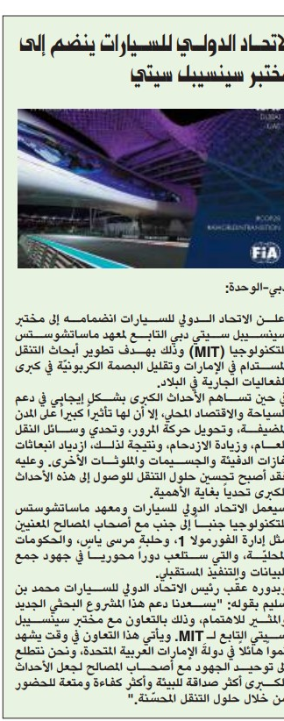
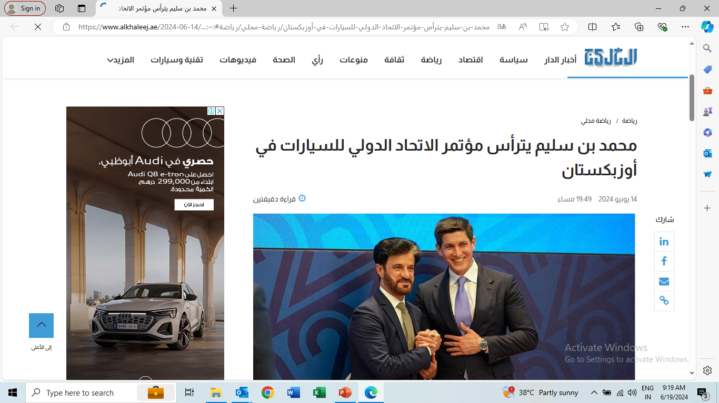
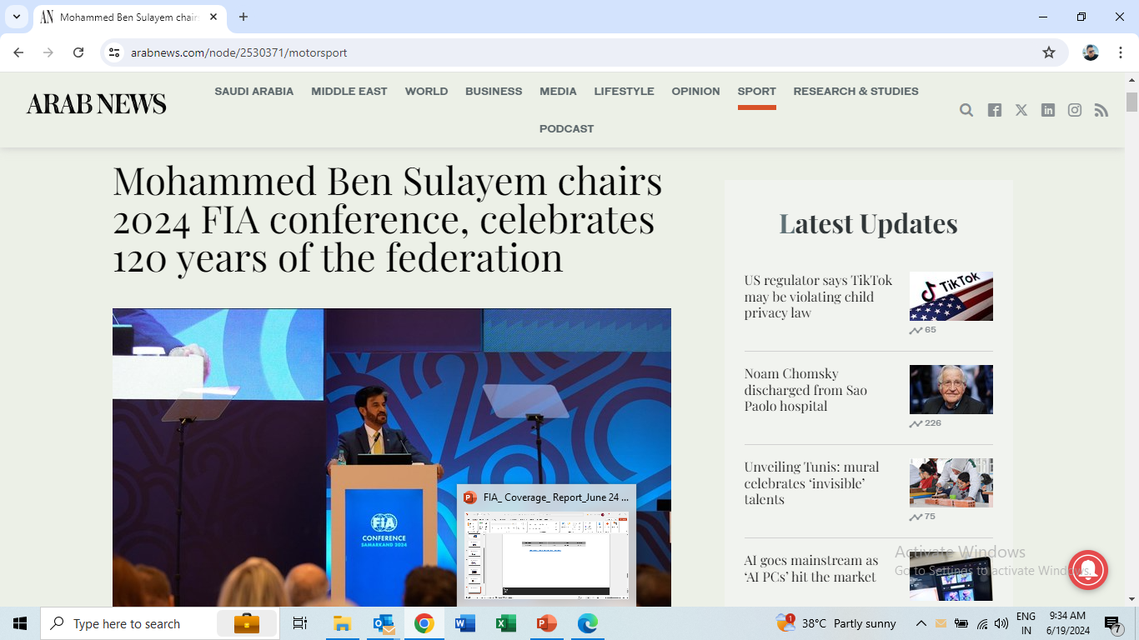
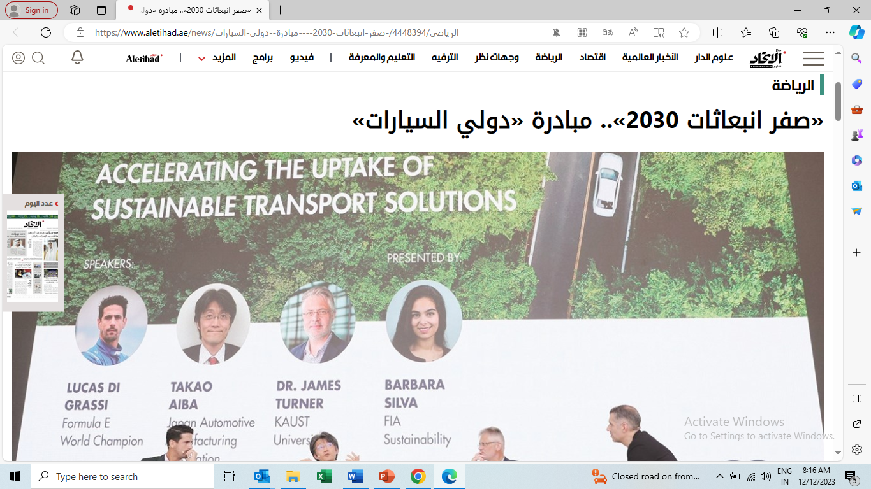
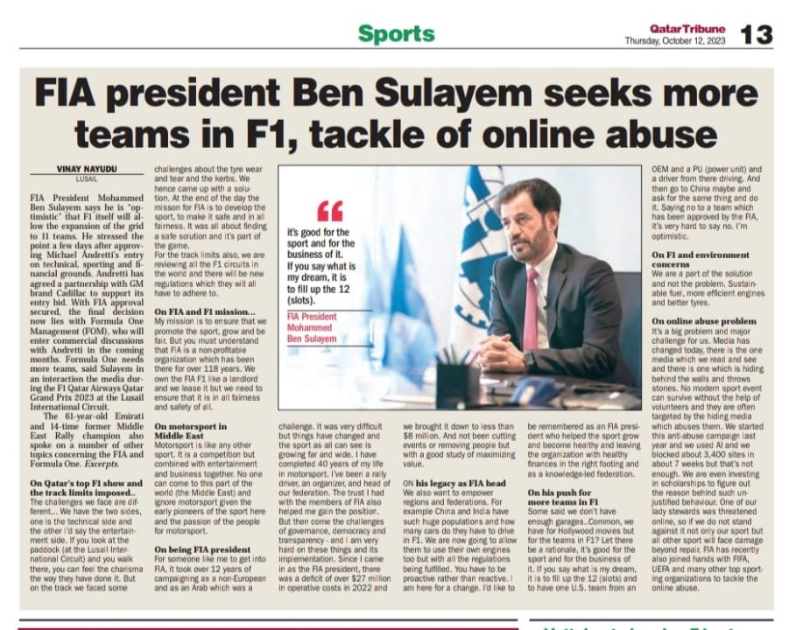
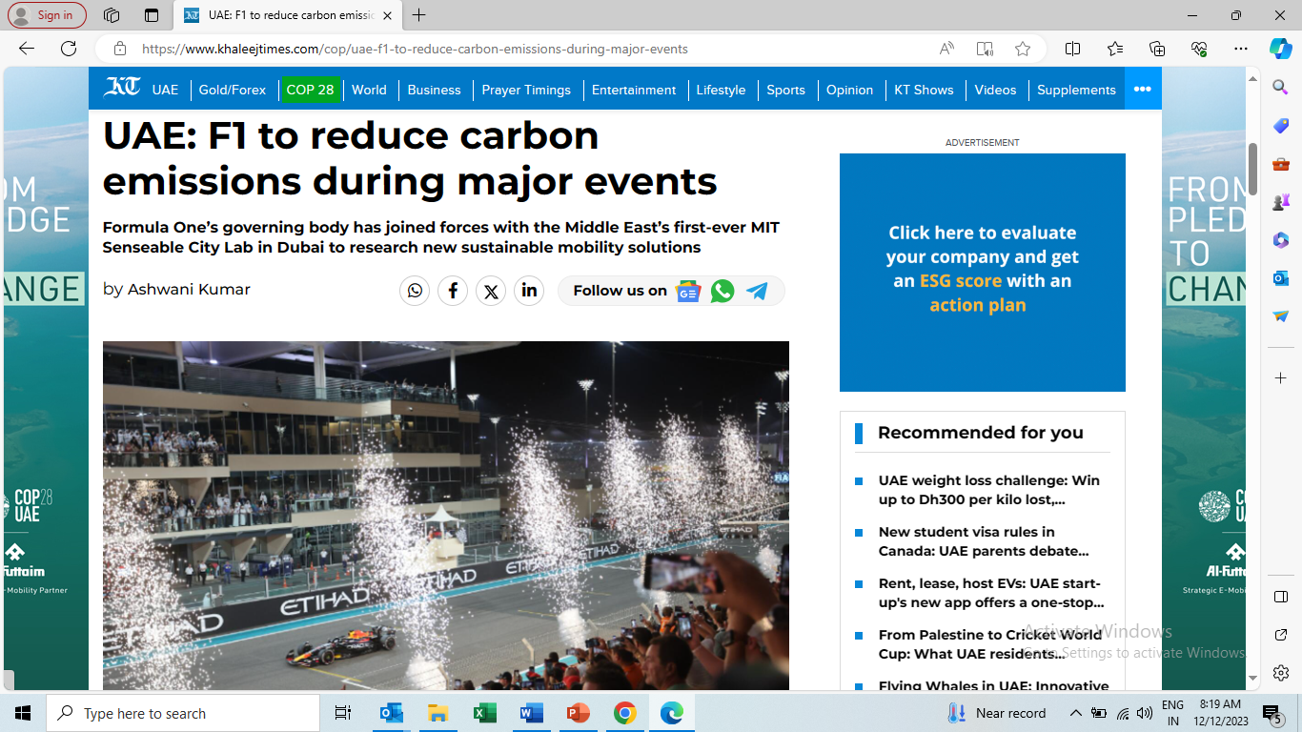
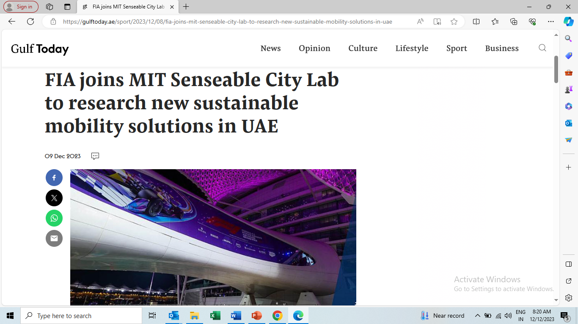
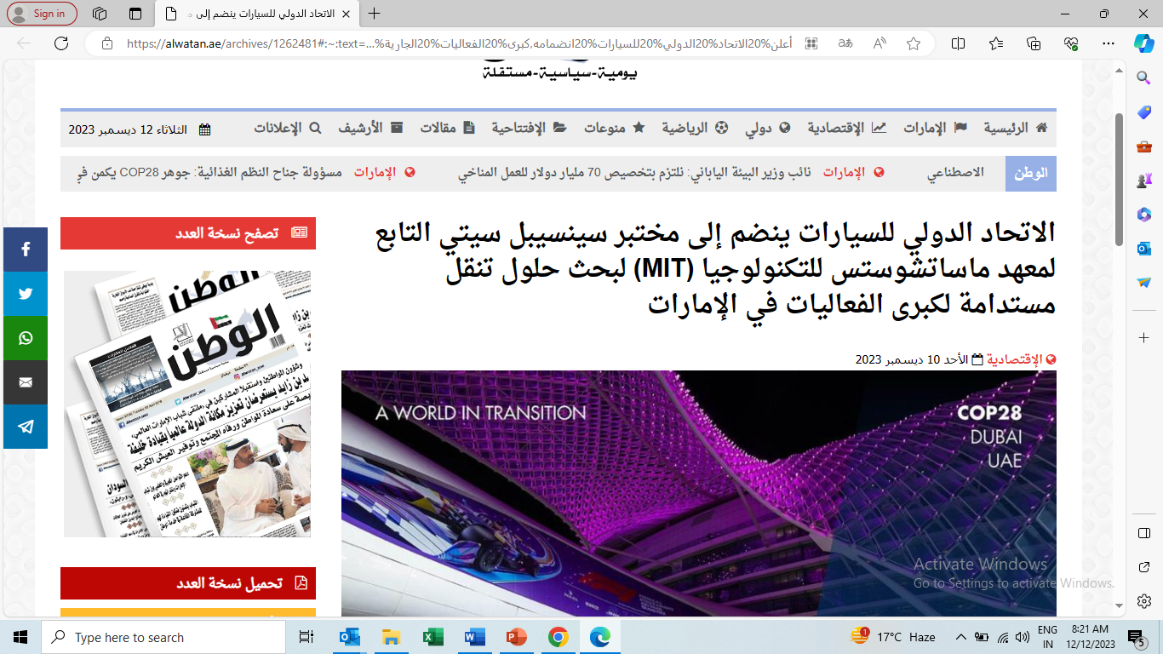
Sample Top-Tier Coverage
Al Khaleej - FIA Conference in Samarkand 2024
Arab News - FIA Conference in Samarkand 2024
Al Wahda - FIA joins MIT Senseable City Lab
Al Etihad- FIA joins MIT Senseable City Lab
Al Watan - FIA joins MIT Senseable City Lab
Khaleej Times - FIA joins MIT Senseable City Lab
The Gulf Today - FIA joins MIT Senseable City Lab
Qatar Tribune - Qatar Grand Prix

Slide 3
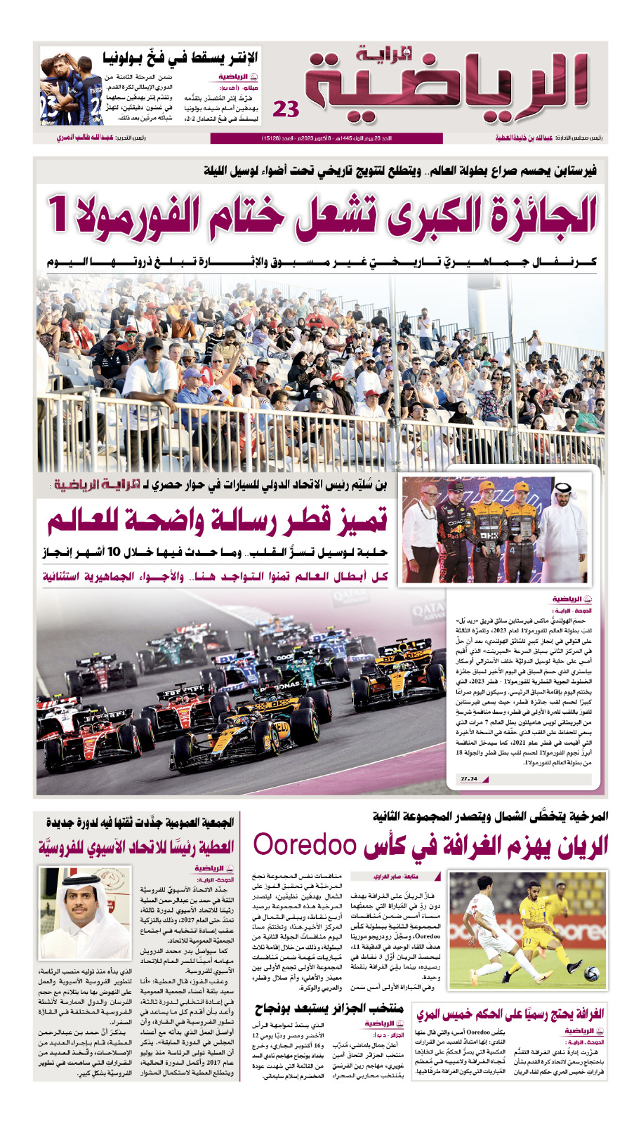
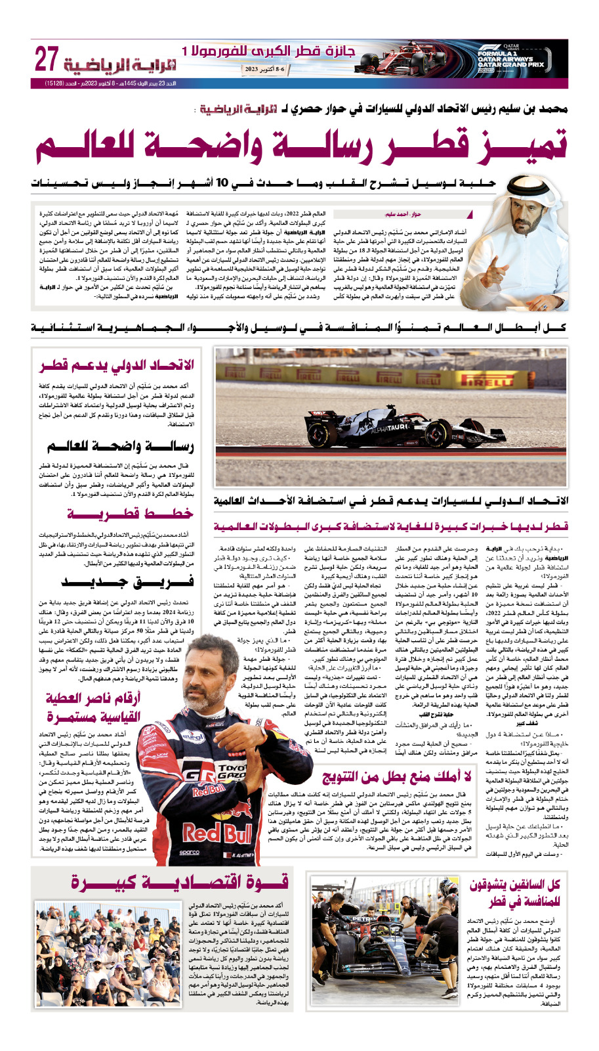
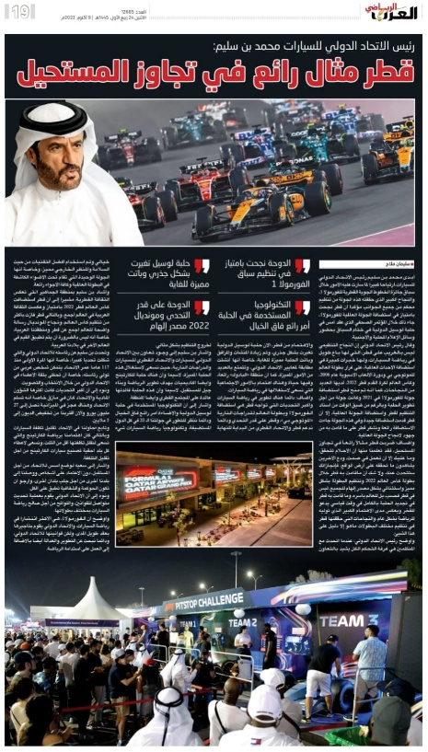
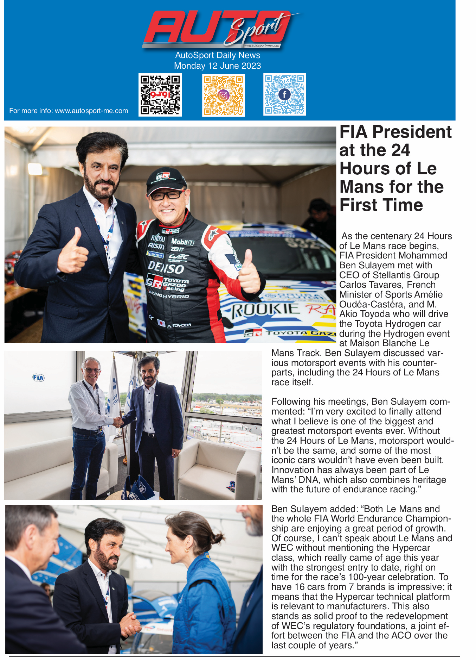
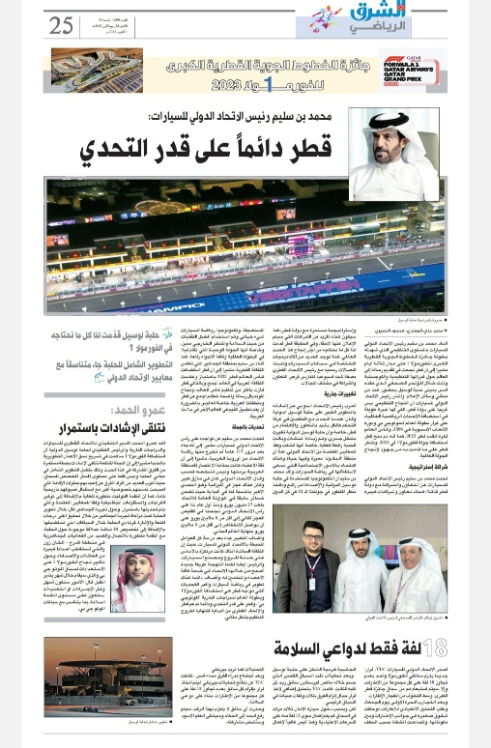
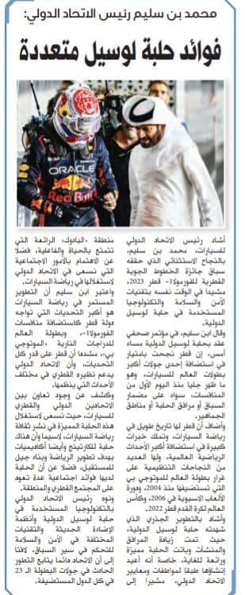
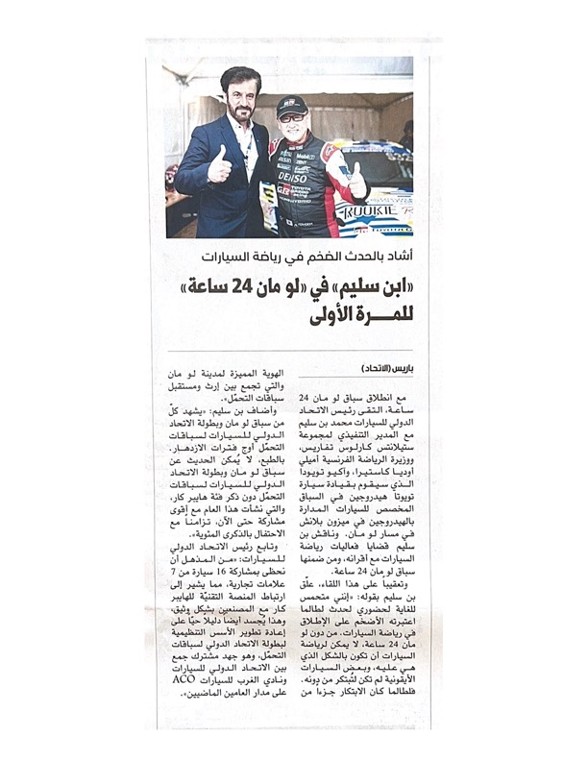
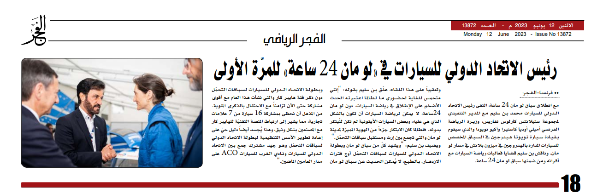
Sample Top-Tier Coverage
Al Raya - Qatar Grand Prix
The Gulf Today - Online abuse puts sports at risk of losing stars – UAOA survey
finds
Auto Sport ME - FIA President at the 24 Hours of Le Mans for the First Time
Al Arab – Qatar Grand Prix
Al Watan (QA) - Qatar Grand Prix
Al Etihad - FIA President at the 24 Hours of Le Mans for the First Time
Al Fajr - FIA President at the 24 Hours of Le Mans for the First Time
Al Sharq - Qatar Grand Prix

Slide 4
Total Coverage & Media Value Summary Stone X
380+
$5M+
120 M+
Total Media Coverage
Estimated PR Media Value
Estimated Reach
In online, print, and TV

Slide 5
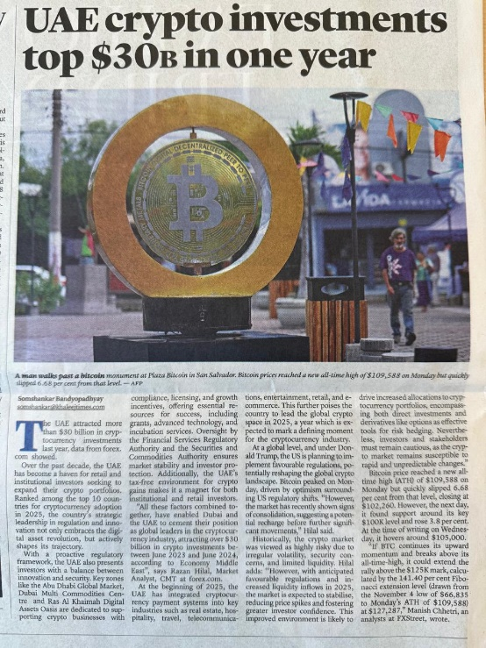
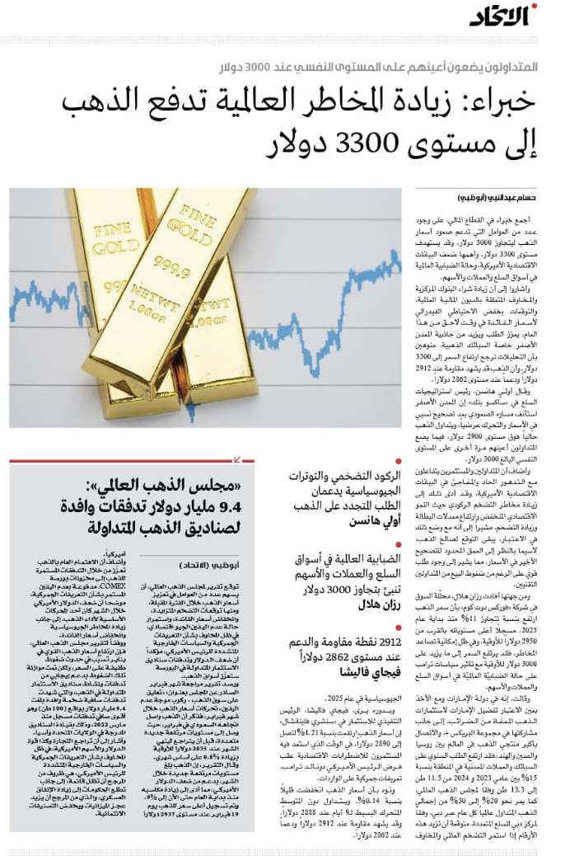
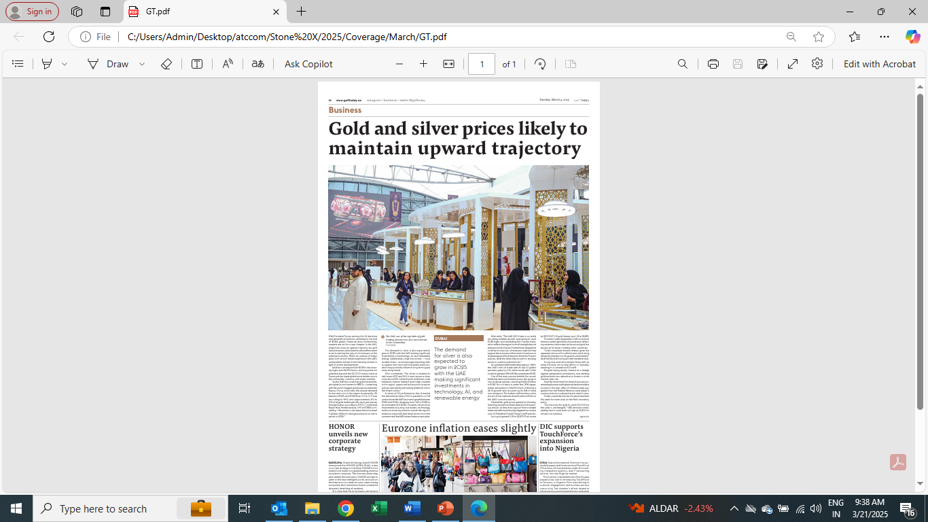
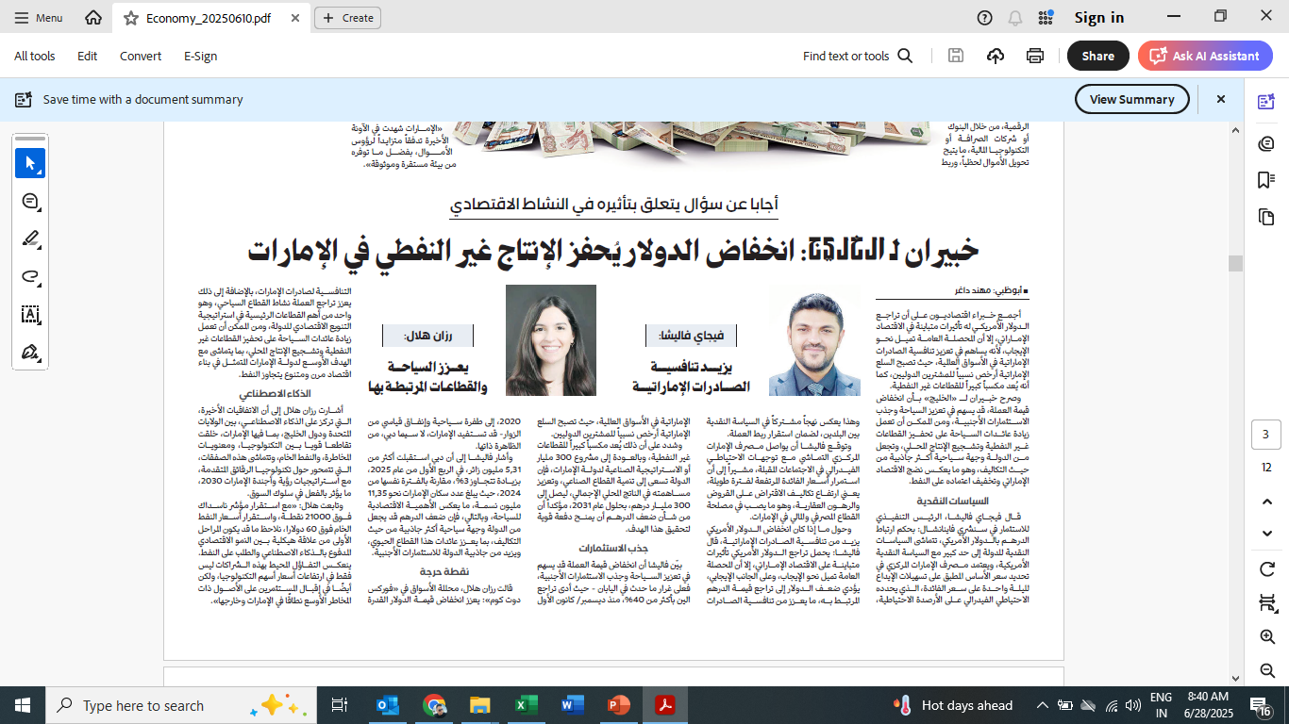
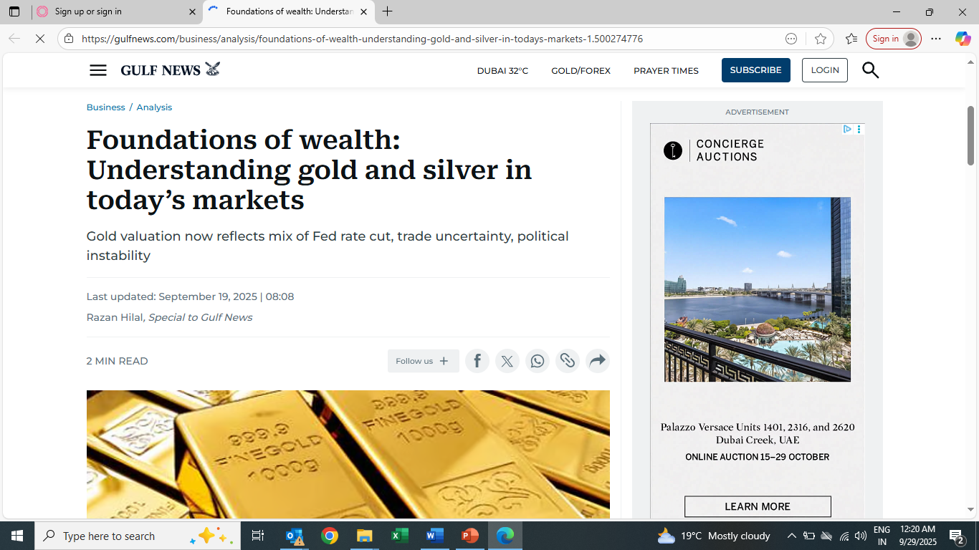
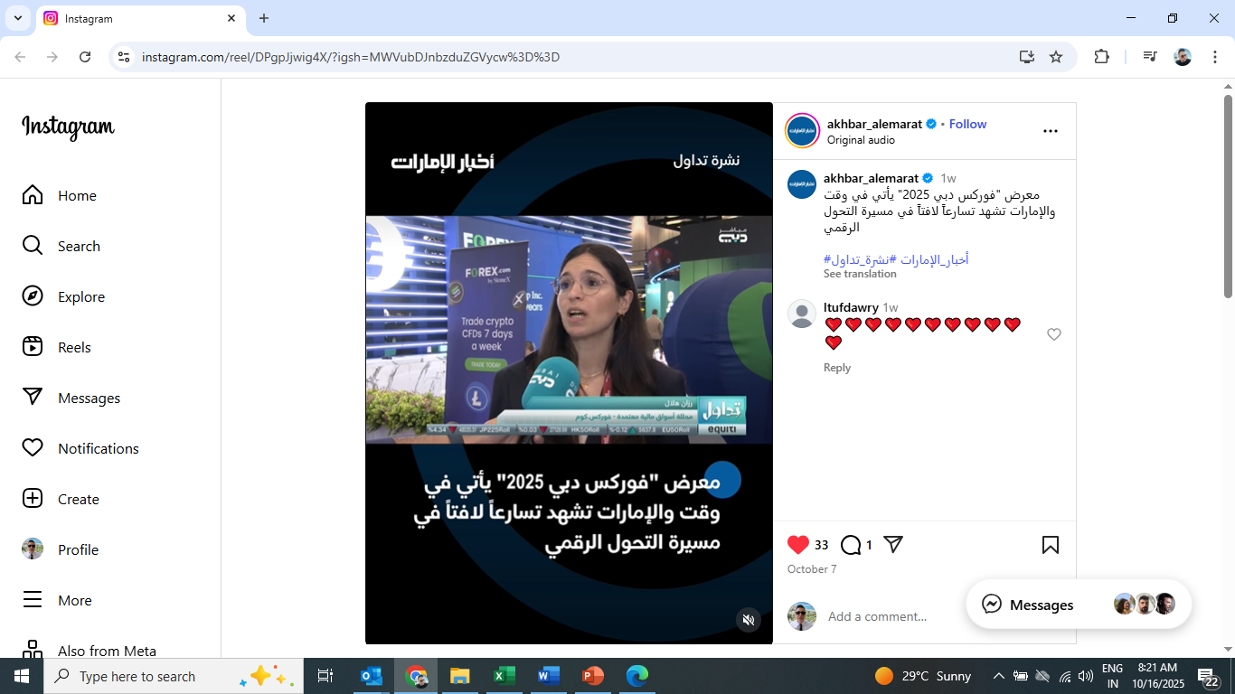
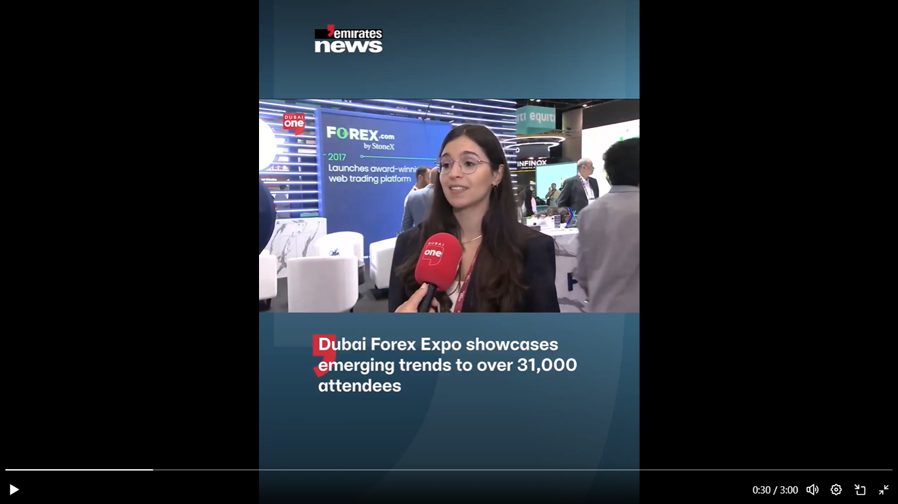
Sample Top-Tier Coverage
Khaleej Times Feature
Crypto Market
Al Ittihad Gold Market Feature
Gulf Today Gold & Silver market updates
Al Khaleej Crude Oil Market updates
Gulf News Opinion Piece
https://gulfnews.com/business
Dubai TV Interview Forex Expo Dubai
https://www.instagram.com/reel/DPgpJjwig4X/?igsh=MWVubDJnbzduZGVycw%3D%3D
Dubai One Emirates News
https://x.com/Emirates_News/status/1975628618748596242?t=iwnr6gsWyUYECtwU2YGODg&s=19

Slide 6
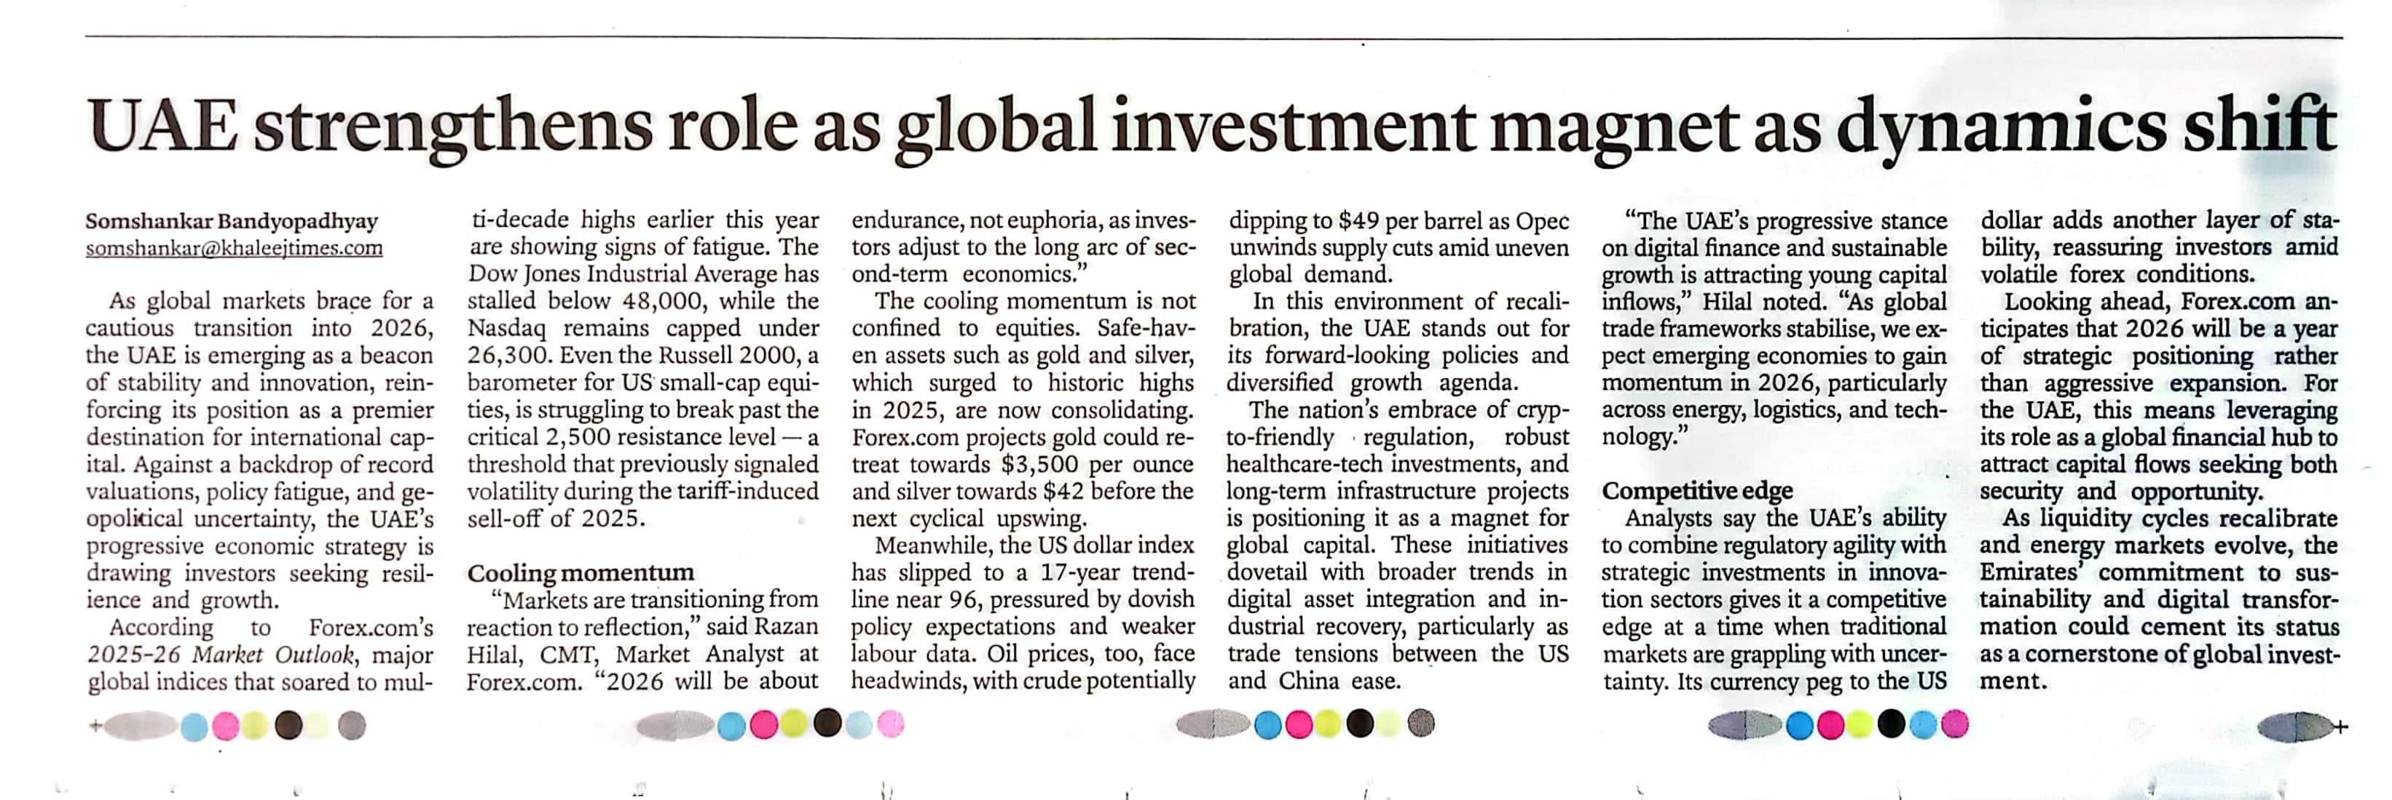
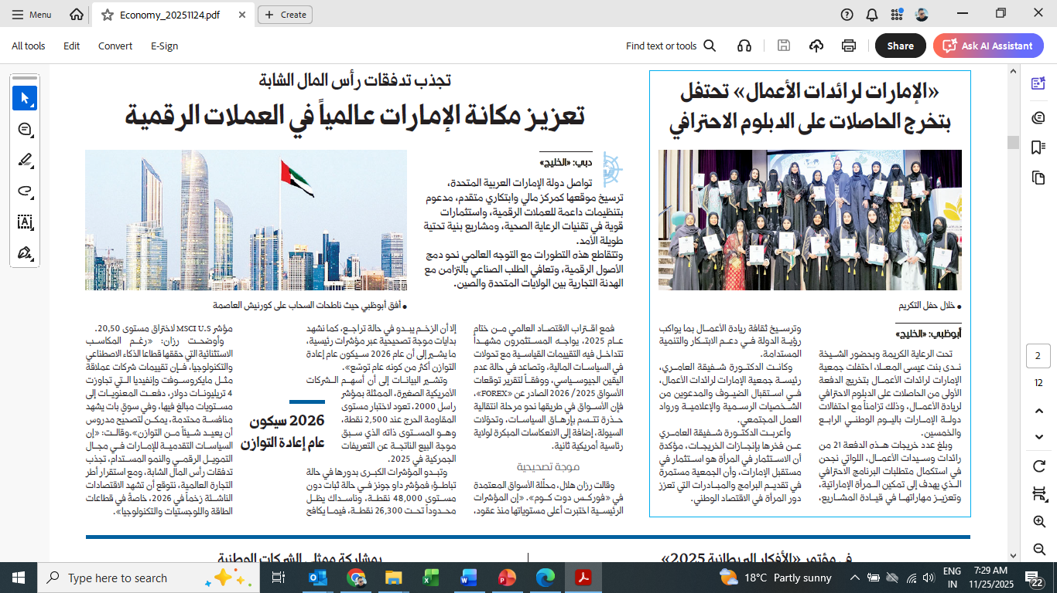
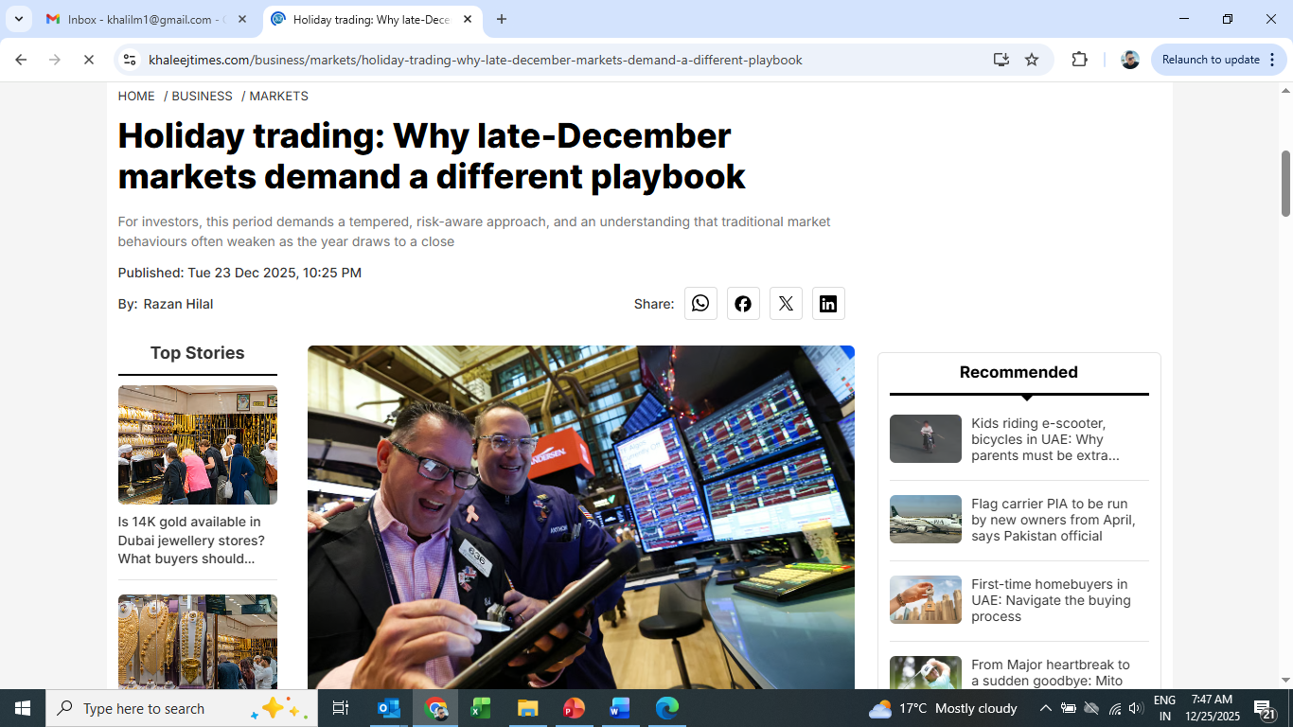
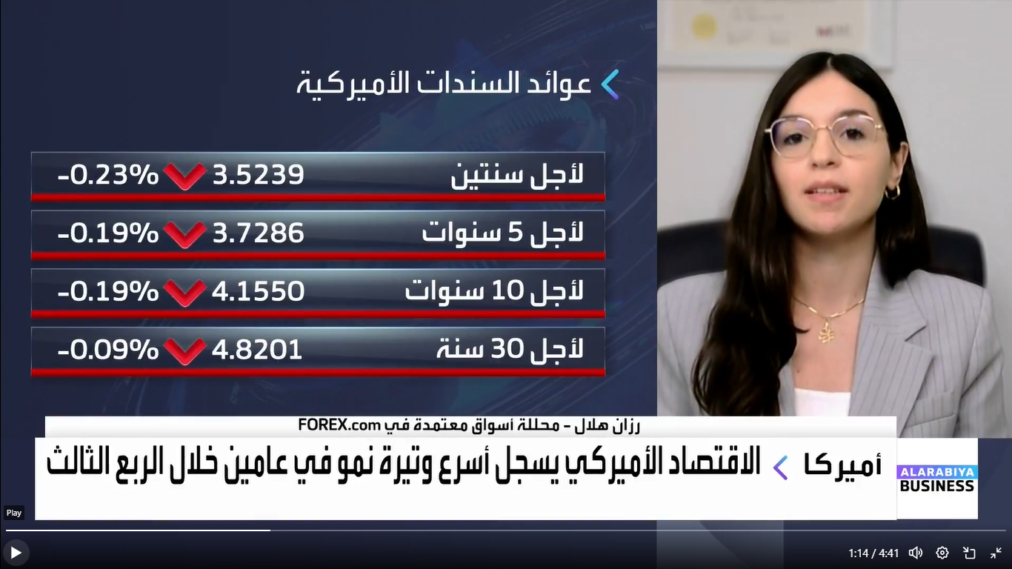
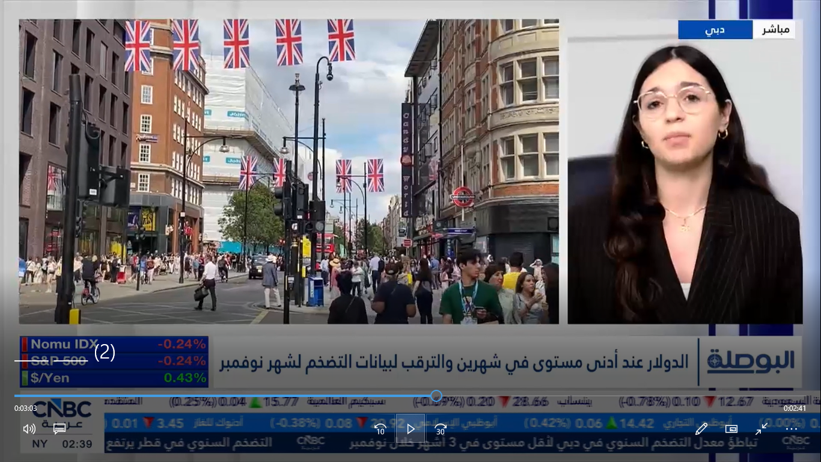
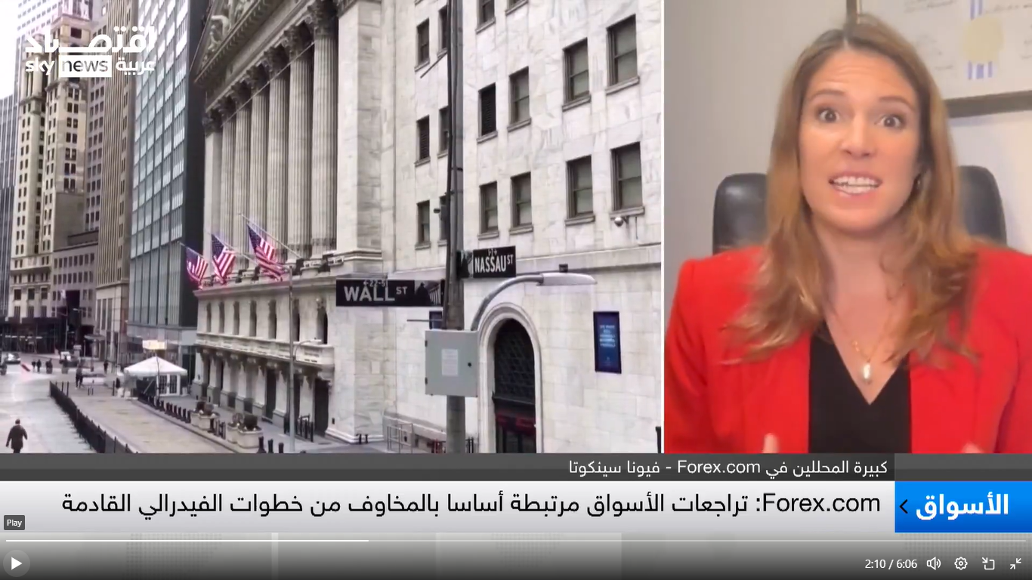
Sample Top-Tier Coverage
Khaleej Times Market Outlook 2025
Al Khaleej Market Outlook 2025-2026
Khaleej Times Holiday Trading
Al Arabiya TV Business Regional Market https://x.com/i/status/2003759662068335065
CNBC Arabia Interview
SkynewsArabia Int’l Market

Slide 7
Total Coverage & Media Value Summary
RDH
375+
$2.278M+
408M+
Total Media Coverage
Estimated PR Media Value
Estimated Reach
In online, print, and social media

Slide 8
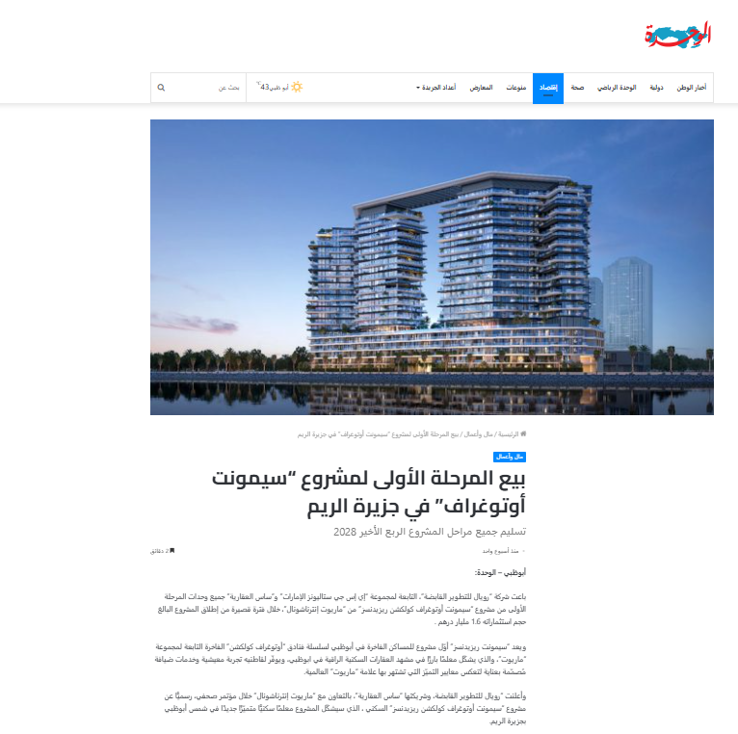
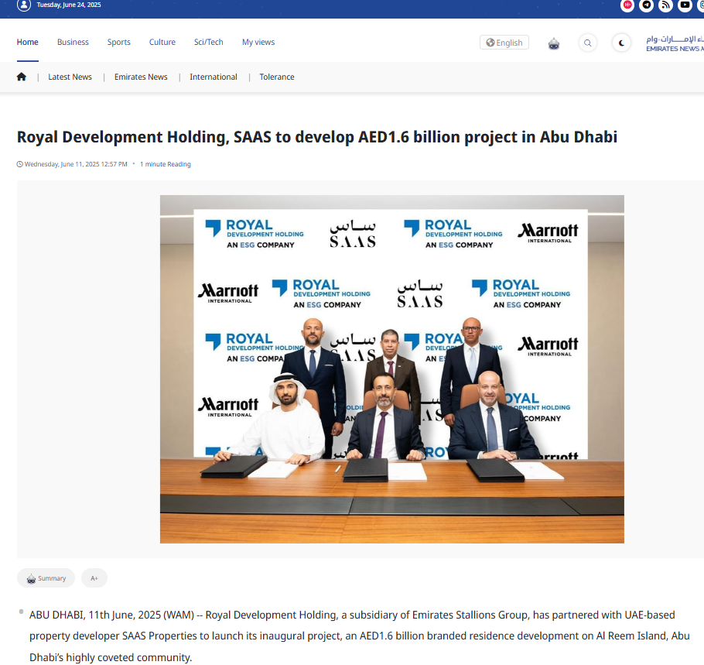
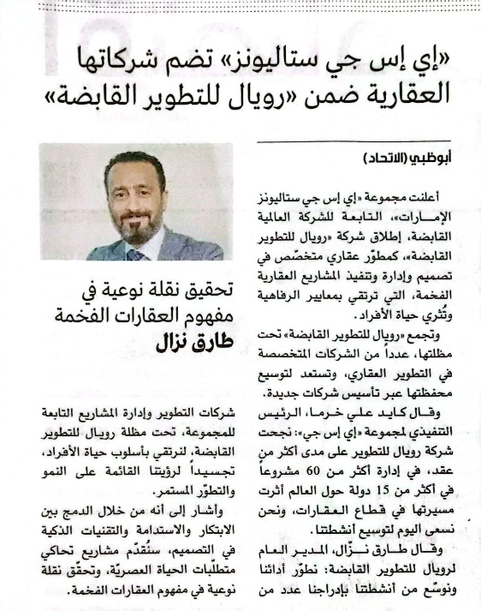
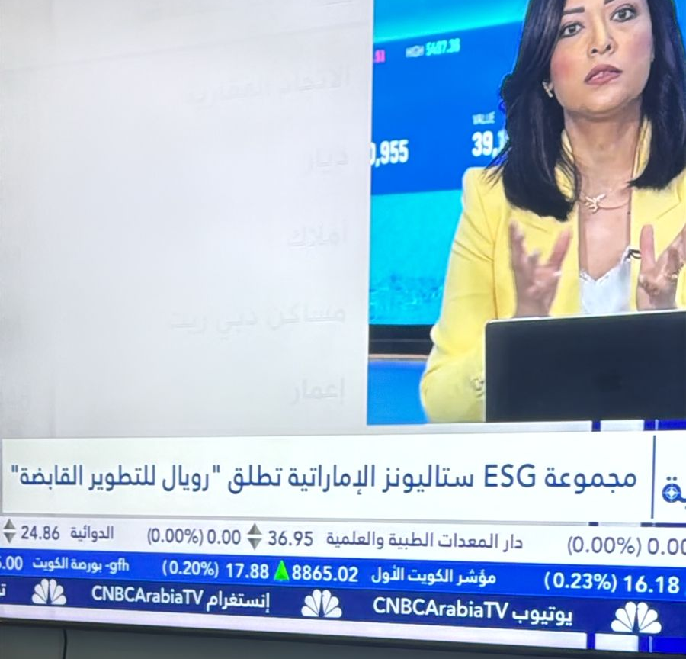
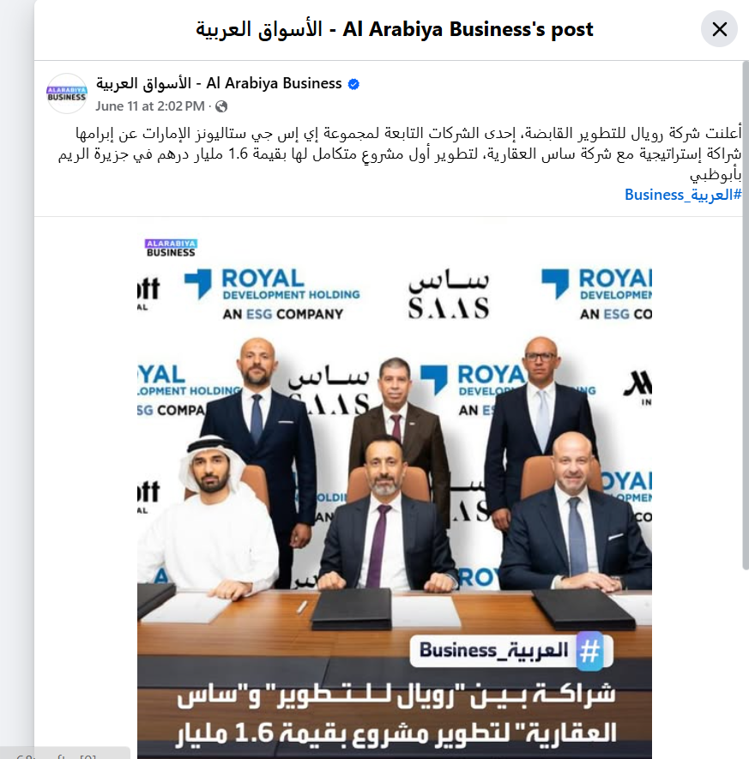
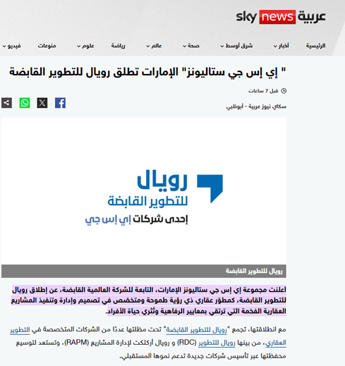
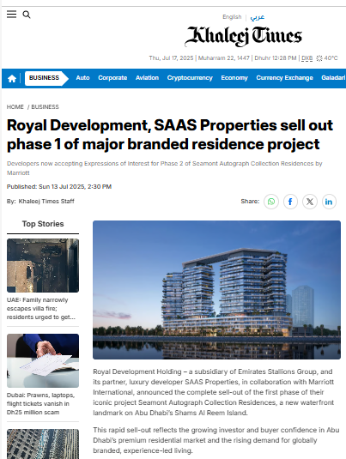
Sample Top-Tier Coverage
Al Wahda Newspaper - First phase of the Seamont Autograph sold out.
WAM - Royal Development Holding, SAAS to develop AED1.6 billion project in Abu Dhabi
Al Etihad - ESG Stallions incorporates its real estate companies into Royal Development Holding.
CNBC TV - ESG Group Launches Royal Development Holding
Al Arabiya Business - Royal Development Holding, SAAS to develop AED1.6 billion project in Abu Dhabi
Sky News Arabia - ESG Group Launches Royal Development Holding
Al Arabiya Business - Royal Development Holding partnership with SAAS Real Estate Company
Khaleej Times - Royal Development, SAAS Properties sell out phase 1 of major branded residence project

Slide 9
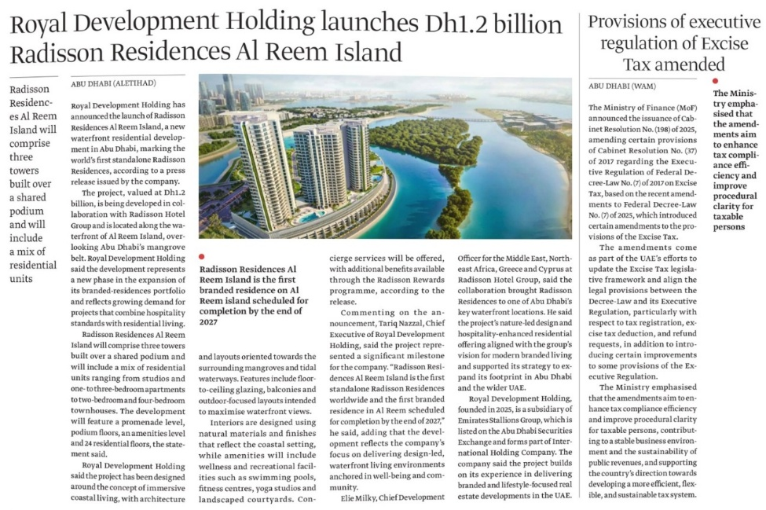
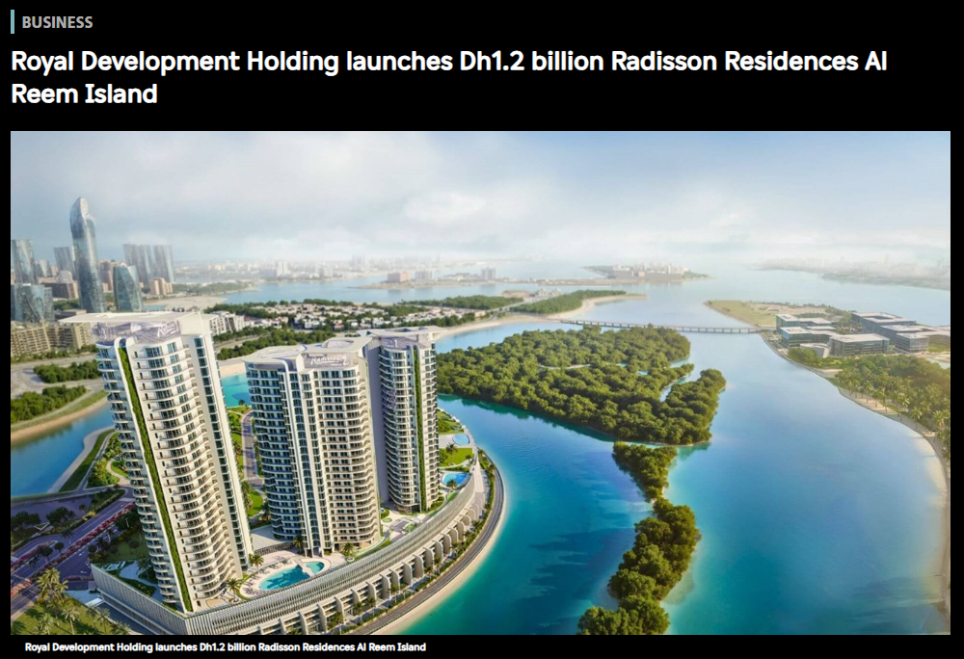
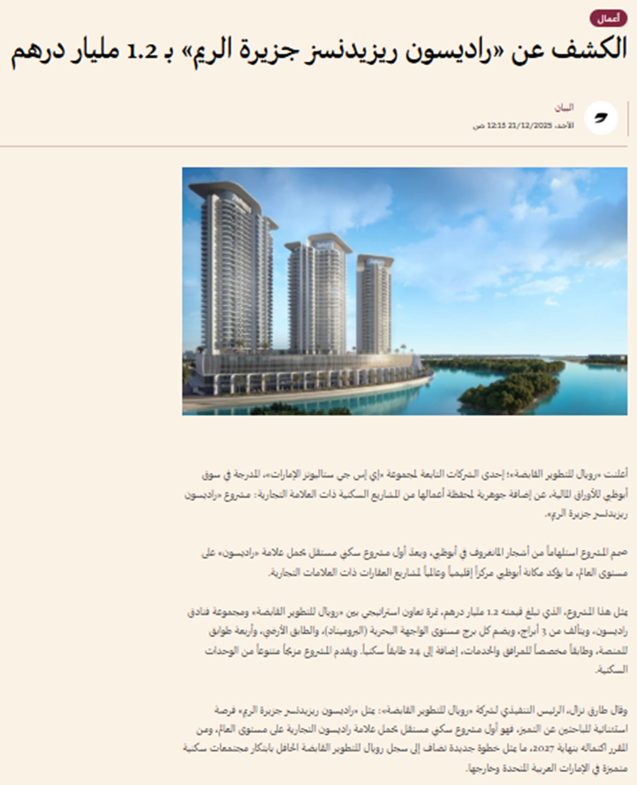
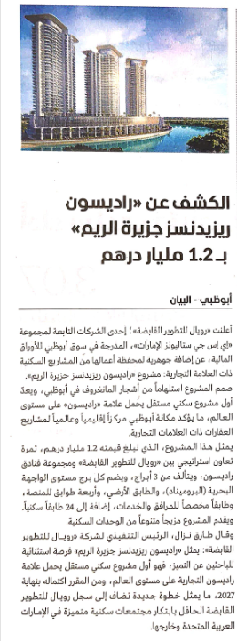
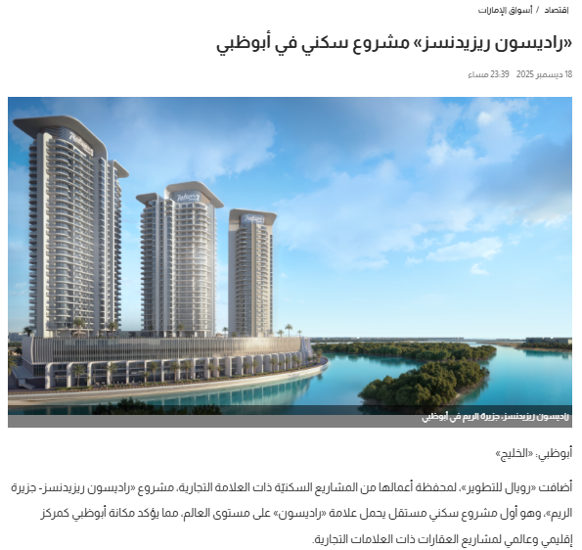
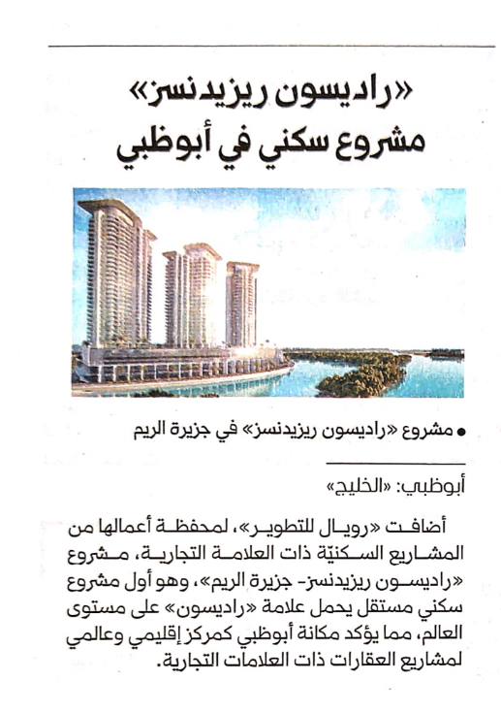
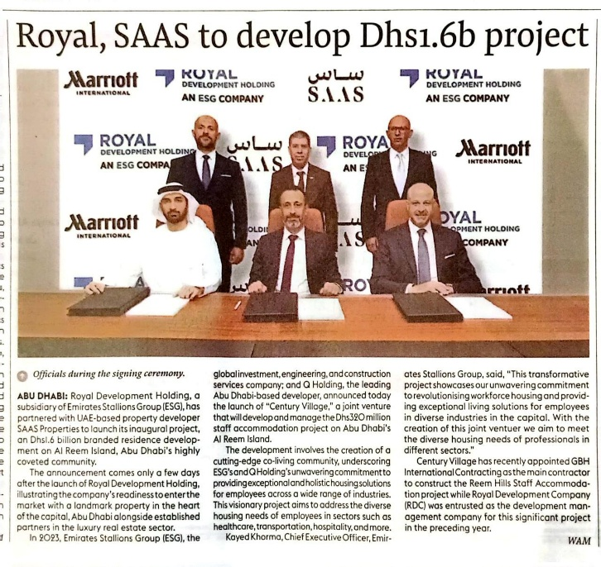
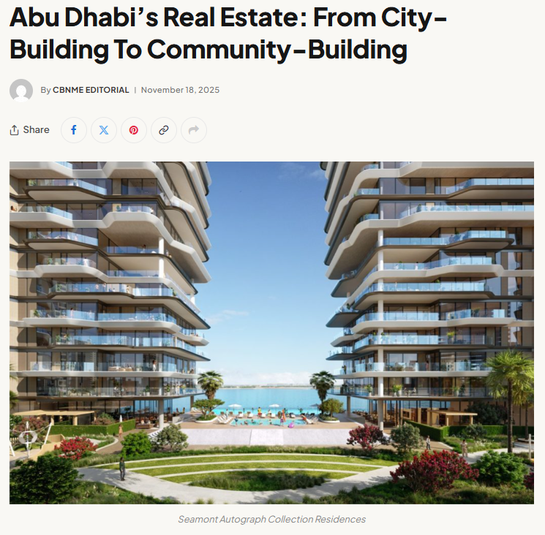
Sample Top-Tier Coverage
Al Etihad (Print and Online) - Royal Development Holding Launches Dh1,2 billion Radisson Residences Al Reem Island
Al Bayan (Print and Online) - Royal Development Holding Launches Dh1,2 billion Radisson Residences Al Reem Island
Al Khaleej (Online and Print) - Radisson Residences is a residential project launch
The Gulf Today - Royal, SAAS to Develop Dh1.6b project
Construction Business News - Feature Article: Abu Dhabi’s Real Estate: From City Building to Community Building

Slide 10
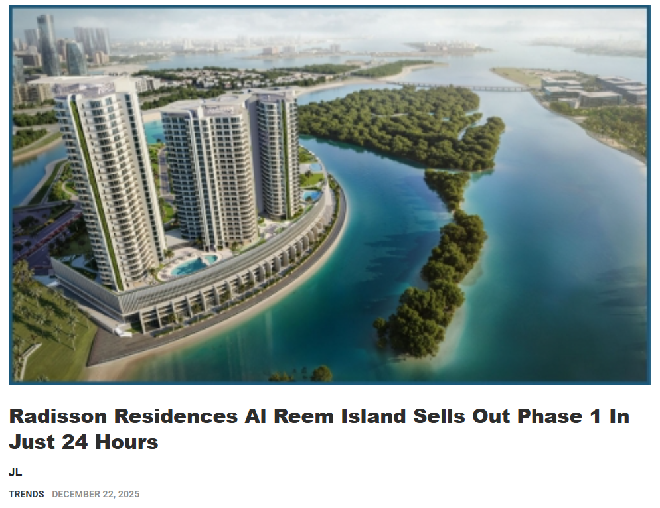
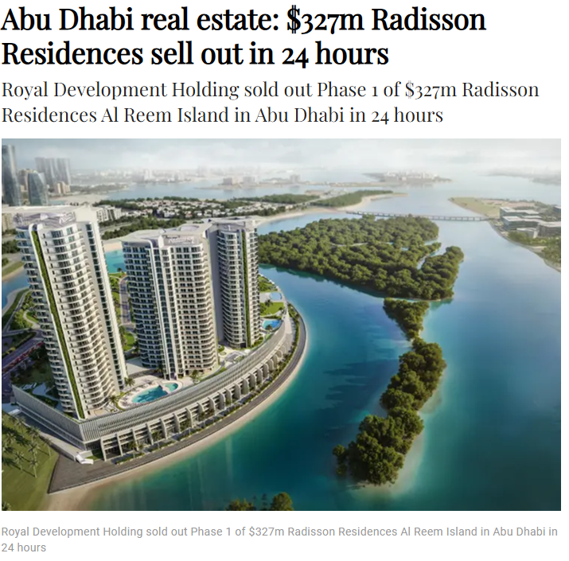
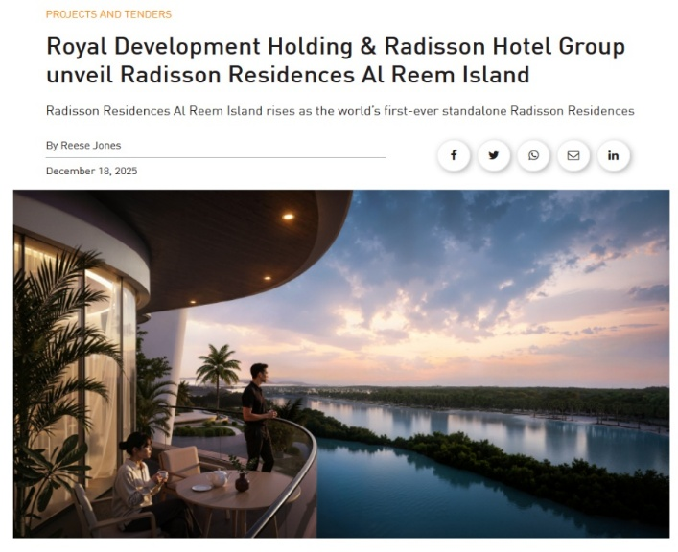
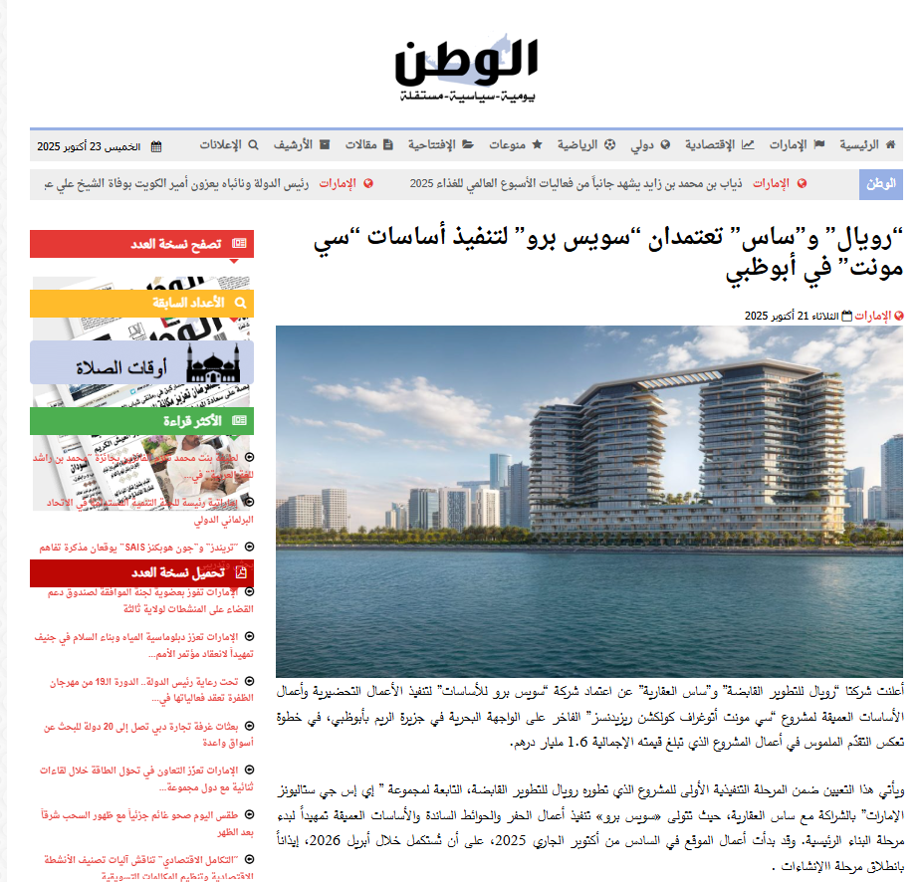
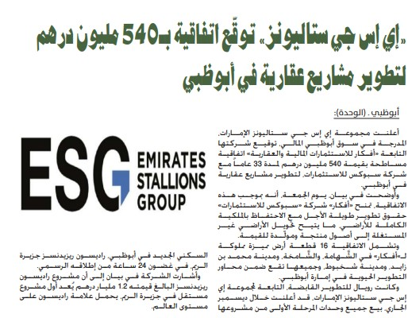
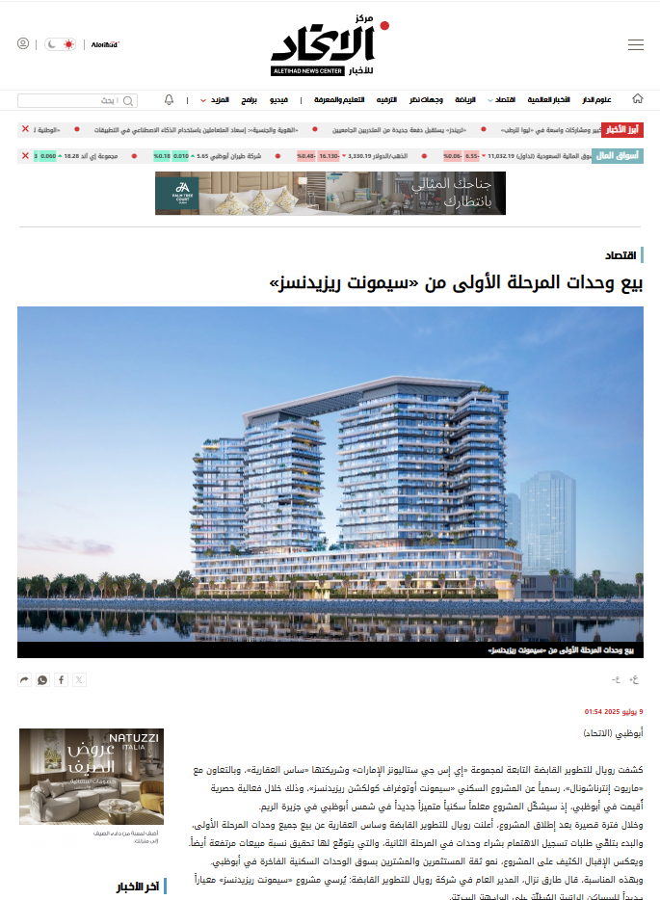

Sample Top-Tier Coverage
The Daily Tribune - Radisson Residences Al Reem Island Sells Out Phase 1 in Just 24 Hours
Arabian Business - Abu Dhabi Real Estate: $327M Radisson Residences sell out in 24 hours
Construction Week - Royal Development Holding & Radisson Hotel Group Unveil Radisson Residences Al Reem Island
Al Watan - Royal and SAS appoint Swiss Pro to execute Seamount foundations in Abu Dhabi
Al Wahda Newspaper - ESG Stallions signs a AED 540 million agreement to develop real estate projects in Abu Dhabi
Al Etihad - First phase units of "Seamont Residences" have been sold

Slide 11
Total Coverage & Media Value Summary CHERY
300+
$2.36M+
163M+
Total Media Coverage
Estimated PR Media Value
Estimated Reach
In online, print, and social media

Slide 12









Sample Top-Tier Coverage
Gears ME - AW Rostamani & Chery UAE fund AED 225K for tuition
Gears ME Feature (ENG and ARA) - Plug-in Hybrid Cars: Myth vs. Reality
Arabs Turbo Product Review - A comprehensive review of the Tiggo 9 — a seven-seater with a size and ambition for luxury
Al Watan - Chery UAE Partners with IUCN to Drive Sustainable Mobility at IUCN World Conservation Congress
The Gulf Today – IUCN World Conservation Congress to be held in capital
Al Khaleej – Chery UAE and IUCN
Motor Mania Interview – Chery’s Zaher Sabbagh on the rise of Chinese cars in the UAE
Al Bayan Interview - TIGGO 9 and Arrizo 8: Plug-In Hybrids Made for the UAE

Slide 13








Sample Top-Tier Coverage
Al Bayan Interview - TIGGO 9 and Arrizo 8: Plug-In Hybrids Made for the UAE
Al Bayan – Chery UAE launches Tiggo 9 PHEV
Al Bayan Interview – UAE car market
Al Bilad Press Feature – Chery Safety Feature
Strive ME – Chery UAE Kicks-Off the First Edition of “Chery Art Hub”
Al Bilad Press – China Paralympic Games Partnership
Assayyarat – Chery UAE Launches AWR

